Slide 1
Chapter 2 Number Systems, Operations, and Codes

Slide 2
What does 5132.13 really mean?
Depends on the number base!
Assuming base 10:
5132.13₁₀ = 5x10³ + 1x10² + 3x10¹ + 2x10⁰ + 1x10⁻¹ + 3x10⁻²
Assuming base 6:
5132.13₆ = 5x6³ + 1x6² + 3x6¹ + 2x6⁰ + 1x6⁻¹ + 3x6⁻²
We often use a subscript to indicate the base.

Slide 3
2.1 Decimal Numbers
The position of each digit in a decimal number indicates the magnitude of the quantity represented and can be assigned a weight
Example
5236.71
= 5×1000+2×100+3×10+6×1+7×0.1+1×0.01
= 5×10³+2×10²+3×10¹+6×10⁰+7×10⁻¹+1×10⁻²

Slide 4
For an arbitrary decimal number

Slide 5
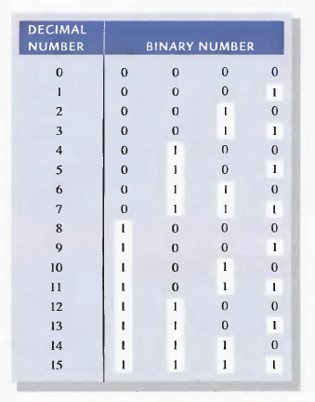
2.2 Binary Numbers
The binary system with its two digits is a base-two system

Slide 6
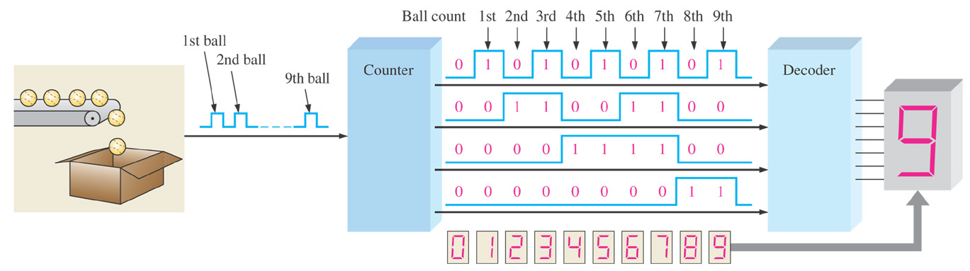
Figure 2–1 Illustration of a simple binary counting application.
A simple binary counting application

Slide 7
Hexadecimal Numbers
Widely used in computer and microprocessor applications
A(10),B(11),C(12),D(13),E(14),F(15);

Slide 8
Conversions
Binary-to-decimal conversions
Adding the weights of all 1s in a binary number to get the decimal value
Decimal-to-binary conversions

Slide 9
Conversion from Binary
Example
-- Convert 101011.11₂ to base 10:
101011.11₂
= 1x2⁵ + 0x2⁴ + 1x2³ + 0x2² + 1x2¹ + 1x2⁰ + 1x2⁻¹ + 1x2⁻²
= 32 + 0 + 8 + 0 + 2 + 1 + ½ + ¼
= 43.75₁₀

Slide 10
Conversion from decimal to binary

Slide 11
Binary-to-hexadecimal conversion
Hexadecimal-to-binary conversion

Slide 12
2.3 Signed Numbers （符号数）
Sign-magnitude form （原码形式）
1’s complement form（反码形式）
2’s complement form（补码形式）

Slide 13
Sign-magnitude Form
A signed number consists of both sign and magnitude information
The sign indicates whether a number is positive or negative
The magnitude is the value of the number
The sign bit
A ‘0’(zero) sign bit indicates a positive number and a ‘1’ sign bit indicates a negative number
00011001
10011001
Magnitude
Magnitude
Sign
Sign

Slide 14
Example
Decimal number | Sign-magnitude form
25 | 0001 1001
-25 | 1001 1001
39 | 0010 0111
-39 | 1010 0111
0 | 0000 0000 1000 0000
Example

Slide 15
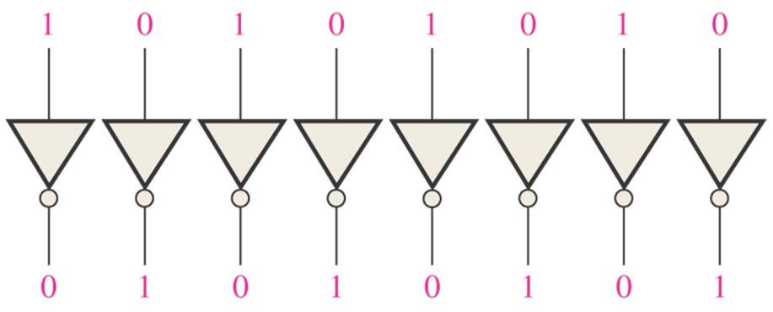
1’s Complement Form of Signed Numbers
Positive numbers: the same as the positive sign-magnitude numbers
Negative numbers: the 1’s complements of the corresponding positive numbers
Change all 1s to 0s and all 0s to 1s

Slide 16
Example
Decimal number | Sing-magnitude form | 1’ s complement form
25 | 0001 1001 | 0001 1001
-25 | 1001 1001 | 1110 0110
39 | 0010 0111 | 0010 0111
-39 | 1010 0111 | 1101 1000
0 | 0000 0000 1000 0000 | 0000 0000 1111 1111
Example
Notes:
See some examples
11111(1C) = -0
10000(1C) = -15
Note there are 32 dots can be expressed for a 5-bit code. 15 dots are placed on the positive axis while 15 dots are placed on the negative axis. The left two dots are on zero.

Slide 17
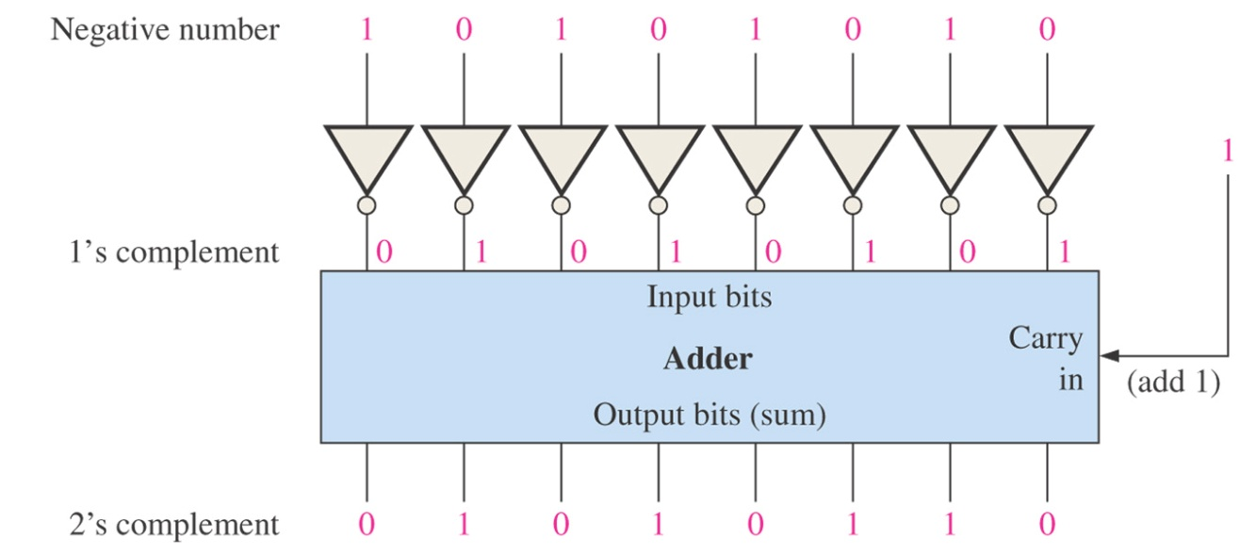
2’s Complement Form of Signed Numbers
Positive numbers: the same as the sign magnitude and 1’s complement forms
Negative numbers: the 2’s complements of the corresponding positive numbers
Adding 1 to the LSB of the 1’s complement
2’s complement = ( 1’s complement ) +1

Slide 18
Example
Decimal number | Sing-magnitude form | 1’ s complement form | 2’s complement form
25 | 0001 1001 | 0001 1001 | 0001 1001
-25 | 1001 1001 | 1110 0110 | 1110 0111
39 | 0010 0111 | 0010 0111 | 0010 0111
-39 | 1010 0111 | 1101 1000 | 1101 1001
0 | 0000 0000 1000 0000 | 0000 0000 1111 1111 | 0000 0000
Example
Notes:
See some examples
11111(2C) = -1
10000(1C) = -16
Note there are 32 dots can be expressed for a 5-bit code. 15 dots are placed on the positive axis while 16 dots are placed on the negative axis. The left one dot is on zero.

Slide 19
Range of Singed Integer Numbers That Can be represented
For 2’s complement signed numbers, the range of values for n-bit numbers is
WHY?
Example

Slide 20
Unsigned integer numbers (magnitude)
0 | 1 | 2 | 3 | 4 | 5 | 6 | 7 | 8 | 9 | 10 | 11 | 12 | 13 | 14 | 15
0000 | 0001 | 0010 | 0011 | 0100 | 0101 | 0110 | 0111 | 1000 | 1001 | 1010 | 1011 | 1100 | 1101 | 1110 | 1111
Signed integer numbers (sign-magnitude form)
-7 | -6 | -5 | -4 | -3 | -2 | -1 | -0 | 0 | 1 | 2 | 3 | 4 | 5 | 6 | 7
1111 | 1110 | 1101 | 1100 | 1011 | 1010 | 1001 | 1000 | 0000 | 0001 | 0010 | 0011 | 0100 | 0101 | 0110 | 0111
Signed integer numbers (1’s complement form)
-7 | -6 | -5 | -4 | -3 | -2 | -1 | -0 | 0 | 1 | 2 | 3 | 4 | 5 | 6 | 7
1000 | 1001 | 1010 | 1011 | 1100 | 1101 | 1110 | 1111 | 0000 | 0001 | 0010 | 0011 | 0100 | 0101 | 0110 | 0111
Signed integer numbers (2’s complement form)
-8 | -7 | -6 | -5 | -4 | -3 | -2 | -1 | 0 | 1 | 2 | 3 | 4 | 5 | 6 | 7
1000 | 1001 | 1010 | 1011 | 1100 | 1101 | 1110 | 1111 | 0000 | 0001 | 0010 | 0011 | 0100 | 0101 | 0110 | 0111

Slide 21
Floating-point Numbers
A floating-point number consists of two parts plus a sign.
The mantissa（尾数部分）: the part of a floating-point number that represents the magnitude of the number.
The exponent（指数部分）: the part of a floating-point number that represents the number of places that the decimal point (or binary point) is to be moved.
Single-precision: 32 bits
Double-precision: 64 bits
Extended-precision: 80 bits

Slide 22
Example
1 0110 1001 0001 = 1.0110 1001 0001 x 2¹²
(Assuming this is a positive number)
Exponent 12+127=139 --------->1000 1011
Mantissa 0110 1001 0001
(The 1 left of the binary point is not included)
S | Exponent | Mantissa (Fraction)
0 | 1000 1011 | 01101001000100000000000
1 bit
8 bit
23 bit
Notes:
https://blog.csdn.net/tercel_zhang/article/details/52537726

Slide 23
Example
Determine the binary value of the following floating-point binary number.
S | Exponent | Mantissa (Fraction)
1 | 10010001 | 10001110001000000000000

Slide 24
2.4 Arithmetic Operations with Binary Numbers
Addition
Subtraction
Multiplication
Division

Slide 25
For Unsigned Numbers

Slide 26
Binary Addition
0 + 0 = 0
0 + 1 = 1
1 + 0 = 1
1 + 1 = 0 and carry 1 to the next column
Examples:
0101 (5₁₀)
+ 0010 (2₁₀)
0111 (7₁₀)
1 1 1
0101 (5₁₀)
+ 0011 (3₁₀)
1000 (8₁₀)
Carries

Slide 27
Binary Addition
Add 6-bit numbers 45₁₀ and 44₁₀ in binary
1 1 1
101101 (45₁₀)
+ 101100 (44₁₀)
1011001 (89₁₀)
Carries
If the operands are unsigned, you can use the final carry-out as the MSB of the result.
Adding 2 k-bit numbers ⬄ k+1 bit result

Slide 28
More Binary Addition
1 1 1 1
1111 (15₁₀)
+ 0001 (1₁₀)
0000 (0₁₀)
If you don’t want a 5-bit result, just keep the lower 4 bits.
Here, 4 bits is insufficient to hold the result (16).
It rolls over back to 0.

Slide 29
For Signed Numbers

Slide 30
Negative Binary Numbers
Several ways of representing negative numbers
Most obvious is to add a sign (+ or -) to the binary integer

Slide 31
Sign-Magnitude
0 is ‘+’
1 is ‘-’
Easy to interpret number value

Slide 32
Sign-Magnitude Examples
0 0 0
0 0011 (+3₁₀)
+ 0 0100 (+4₁₀)
0 0111 (+7₁₀)
0 0 0
1 0011 (-3₁₀)
+ 1 0100 (-4₁₀)
1 0111 (-7₁₀)
Signs are the same, just add the magnitudes

Slide 33
Another Sign-Magnitude Example
Signs are different:
determine which has larger magnitude
0 0101 (+5₁₀)
+ 1 0011 (-3₁₀)
Put larger magnitude number on top
Subtract
Result has sign of larger magnitude number…
0 0101 (+5₁₀)
- 1 0011 (-3₁₀)
0 0010 (+2₁₀)

Slide 34
Yet Another Sign-Magnitude Example
Signs are different:
determine which has
larger magnitude
0 0010 (+2₁₀)
+ 1 0101 (-5₁₀)
Put larger magnitude number on top
Subtract
Result has sign of larger magnitude number…
1 0101 (-5₁₀)
- 0 0010 (+2₁₀)
1 0011 (-3₁₀)

Slide 35
Sign-Magnitude Form
Addition requires two separate operations
addition
subtraction
Several decisions:
Signs same or different?
Which operand is larger?
What is sign of final result?
Two zeroes (+0, -0)

Slide 36
Sign-Magnitude
Advantages
Easy to understand
Disadvantages
Two different 0s
Hard to implement in logic

Slide 37
One’s Complement
Positive numbers are the same as sign-magnitude
-N is represented as the 1’s complement of N:
-N = N’

Slide 38
One’s Complement Examples
000101 (5₁₀)
+ 010100 (20₁₀)
011001 (25₁₀)
1 1 0 0
0101 (5₁₀)
+ 1100 (-3₁₀)
0001 0010 (+2₁₀)
+
If there is a carry out on the left, it must be wrapped around and added back in on the right

Slide 39
One’s Complement
Addition complicated by end around carry
No decisions (unlike sign-magnitude)
Still two zeroes (+0, -0)

Slide 40
One’s Complement
Advantages
Easy to generate –N
Only one addition process
Disadvantages
End around carry
Two different 0s

Slide 41
Two’s Complement
Treat positional digits differently
0111_{2C} = -0 x 2³ + 1 x 2² + 1 x 2¹ + 1 x 2⁰ = 7₁₀
1111_{2C} = -1 x 2³ + 1 x 2² + 1 x 2¹ + 1 x 2⁰ = -1₁₀
Most significant bit (MSB) given negative weight…
Other bits same as in unsigned

Slide 42
Two’s Complement

Slide 43
Sign-Extension in 2’s Complement
To make a k-bit number wider
replicate sign bit
110_{2C} = -1 x 2² + 1 x 2¹ = -2₁₀
1110_{2C} = -1 x 2³ + 1 x 2² + 1 x 2¹ = -2₁₀
11110_{2C} = -1 x 2⁴ + 1 x 2³ + 1 x 2² + 1 x 2¹ = -2₁₀

Slide 44
More Sign-Extension
010_{2C} = 1 x 2¹ = 2₁₀
0010_{2C} = 1 x 2¹ = 2₁₀
00010_{2C} = 1 x 2¹ = 2₁₀
Works for both positive and negative numbers!

Slide 45
Negating a 2’s Complement Number
Invert all the bits
Add 1
+2₁₀ = 0010_{2C} → 1101 + 1 = 1110_{2C} = -2₁₀
-2₁₀ = 1110_{2C} → 0001 + 1 = 0010_{2C} = +2₁₀

Slide 46
Two’s Complement Addition
0 0 1
0101 (+5₁₀)
+ 0001 (+1₁₀)
0110 (+6₁₀)
1 1 1
1011 (-5₁₀)
+ 1111 (-1₁₀)
1010 (-6₁₀)
Operation is same as for unsigned.
Same rules, same procedure.
Interpretation of operands and
results are different.
1 1 0
0110 (+6₁₀)
+ 1111 (-1₁₀)
0101 (+5₁₀)

Slide 47
Two’s Complement
Addition always the same
Only 1 zero
Negation somewhat complicated
The representation of choice

Slide 48
2.5 Binary Coded Decimal (BCD)
A way to express each of the decimal digits with a binary code
The 8421 Code
0 --------> 0000
1 --------> 0001
…
9 --------> 1001

Slide 49
Convert 2496₁₀ to BCD Code
2 4 9 6
0 0 1 0 0 1 0 0 1 0 0 1 0 1 1 0
Note this is very different from converting
to binary which yields:
1 0 0 1 1 1 0 0 0 0 0 0₂

Slide 50
ASCII Code
ASCII ➔ American Standard Code for Information Interchange
ASCII is a 7-bit code used to represent letters, symbols, and terminal codes
There are also Extended ASCII codes, represented by 8-bit numbers
Terminal codes include such things as: Tab (TAB) Line feed (LF) Carriage return (CR) Backspace (BS) Escape (ESC) And many more!

Slide 51
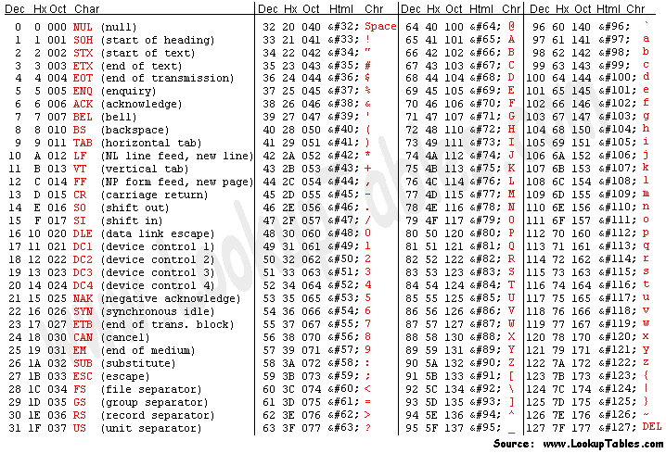
ASCII Code

Slide 52
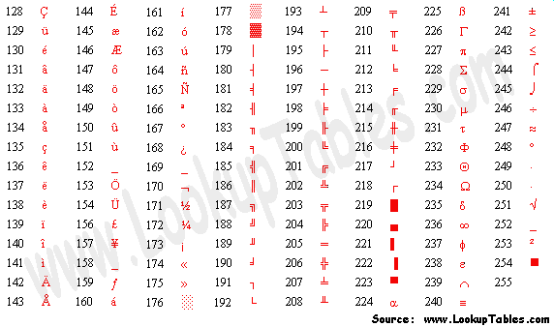
Extended ASCII Code

Slide 53
ASCII Code (partial)
Convert “help” to ASCII
h e l p
1101000 1100101 1101100 1111000
0x68 0x65 0x6C 0x70

Slide 54
2.6 Digital Codes
The Gray Code
Unweighted and not an arithmetic code
No specific weights assigned to the bit positions
Important feature: exhibits only a single bit change from one code word to the next in sequence

Slide 55
Table 2-6 Four-bit Gray code
DECIMAL | BINARY | GRAY CODE | DECIMAL | BINARY | GRAY CODE
0 | 0000 | 0000 | 8 | 1000 | 1100
1 | 0001 | 0001 | 9 | 1001 | 1101
2 | 0010 | 0011 | 10 | 1010 | 1111
3 | 0011 | 0010 | 11 | 1011 | 1110
4 | 0100 | 0110 | 12 | 1100 | 1010
5 | 0101 | 0111 | 13 | 1101 | 1011
6 | 0110 | 0101 | 14 | 1110 | 1001
7 | 0111 | 0100 | 15 | 1111 | 1000

Slide 56
Binary-to-Gary Code Conversion
The MSB in the Gray code is the same as the corresponding MSB in the binary number
Going from left to right, add each adjacent pair of binary code bits to get the next Gray code bit
Discard carries
Example
10110 (binary) --------> 11101 (Gray code)

Slide 57
Gray-to-Binary Conversion
The MSB in the binary code is the same as the corresponding bit in the Gray code
Add each binary code bit generated to the Gray code bit in the next adjacent position
Discard carries
Example
11011 (Gray code) --------> 10010 (binary)

Slide 58
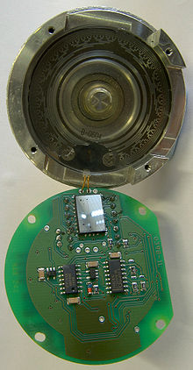
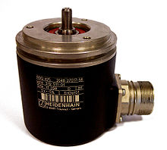
An application of Gray Code
Rotary encoder

Slide 59
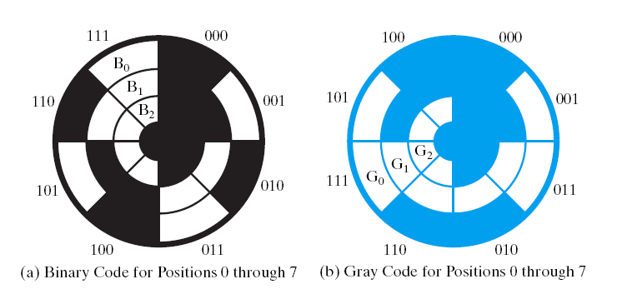

Slide 60
Standard Binary Encoding
Sector | Contact 1 | Contact 2 | Contact 3 | Angle
0 | off | off | off | 0° to 45°
1 | off | off | ON | 45° to 90°
2 | off | ON | off | 90° to 135°
3 | off | ON | ON | 135° to 180°
4 | ON | off | off | 180° to 225°
5 | ON | off | ON | 225° to 270°
6 | ON | ON | off | 270° to 315°
7 | ON | ON | ON | 315° to 360°
Gray Coding
Sector | Contact 1 | Contact 2 | Contact 3 | Angle
0 | off | off | off | 0° to 45°
1 | off | off | ON | 45° to 90°
2 | off | ON | ON | 90° to 135°
3 | off | ON | off | 135° to 180°
4 | ON | ON | off | 180° to 225°
5 | ON | ON | ON | 225° to 270°
6 | ON | off | ON | 270° to 315°
7 | ON | off | off | 315° to 360°

Slide 61
Summary
Number systems
Binary, decimal, hexadecimal
Singed number
Arithmetic operation
Codes

Slide 62
HW (Edition10)
Page 59~62
11
15
22
23
31
51
56

